Slide 1

SELF DRIVING CAR PROJECT
Team Members:
Aditya
Vybhav
Irbaz

Slide 2

PROJECT DESCRIPTION
1) About the problem:
2) The solution:
3) How does AI help in making this possible:

Slide 3

ABOUT THE PROBLEM
Every year, traffic accidents account for 2.2% of global deaths. That stacks up to roughly 1.3 million a year — 3,287 a day.
On top of this, some 20–50 million people are seriously injured in auto-related accidents each year.
What are the causes of the problem?
The root of these accidents? Human error. From distracted driving to drunk driving to reckless driving to careless driving, one poor or inattentive decision could be the difference between a typical drive and a life-threatening situation.
But what if we could neutralize human error from the equation?

Slide 4
THE SOLUTION
What are self-driving cars?
A self-driving automobile is a vehicle that navigates between destinations without a driver by utilizing sensors, cameras, radar, and artificial intelligence (AI). A vehicle must be capable of navigating to a predefined location across roads that have not been modified for its usage in order to be considered completely autonomous.
How can we implement this?
Self-driving cars are majority implemented through the use of many sensors, actuators, complex algorithms, machine learning systems,
And powerful processors to execute software. Autonomous cars create and maintain a map of their surroundings based on a variety of sensors situated in different parts of the vehicle.

Slide 5

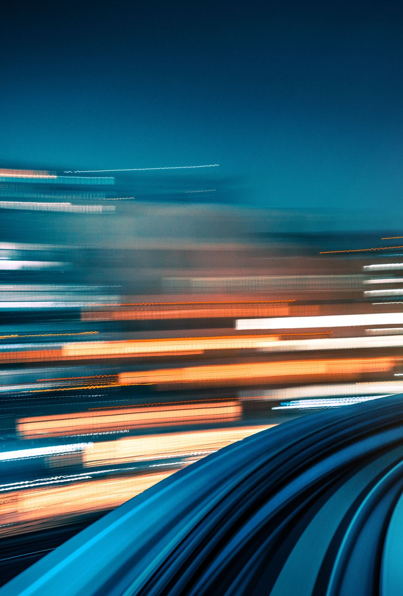
HOW DOES AI HELP IN MAKING THIS POSSIBLE
The AI simulates human perceptual and decision-making processes using deep learning and controls actions in driver control systems,
such as steering and brakes. AI can improve the quality of crash data collection and analysis,
provide insights on how to avert collisions, and improve the response after crashes.
The resulting insights can, in turn, help shape more effective regulatory frameworks for road safety.

Slide 6
DATA DESCRIPTION
The dataset was obtained from github
The images contain various angles of the track ( straight paths, turns, inclines ,and declines)
The dataset has 6 columns — center, left, right, steering, throttle, reverse, speed (values)
In this project, the Udacity driving simulator has been used which has two different tracks. One of them was used for collecting training data,
And the other one — never seen by the model — as a substitute for the test set. The driving simulator would save frames from three front-facing "cameras",
recording data from the car's point of view; as well as various driving statistics like throttle, speed and steering angle.
We are going to use camera data as model input and expect it to predict the steering angle in the [-1, 1] range.

Slide 7
Methodology
We have found references needed to create the model,
so we are few steps closer to building it.
We first need an algorithm that will act as the foundation from which the program can be coded.
The algorithm we will be using is Neural Network algorithm.
There are different types of Neural Network Classifications, for example:
Deep Neural Networks (DNN)
Convolution Neural Networks (CNN)
Recurrent Neural Networks (RNN)

Slide 8
CNN
Convolution Neural Network:
An image data processing deep learning algorithm called a convolutional neural network (CNN) was created for this purpose.
In order to recognize and process images, complicated neural networks are used.
The frontal lobe of the human brain, which is the area of the brain in charge of processing visual stimuli,
is represented by the neural networks in a CNN.
The advantages of convolutional neural networks include:
They can detect important features without human supervision
It has the highest accuracy amongst image detection algorithms
It is easy to understand and implement.

Slide 9
RNN
Recurrent Neural Network:
A recurrent neural network (RNN) is an artificial neural network that uses sequential or time-series data to solve problems
in speech recognition and language translation.
RNNs have been used in:
Language translation
Natural language processing
Speech recognition
Image captioning
The connections between nodes in recurrent neural networks create directed or undirected graphs across a temporal series.
RNNs are the most effective neural networks for machine learning tasks using sequential input since these neurons contain an internal memory.

Slide 10
DNN
Deep Neural Network:
A deep neural network (DNN) is an artificial neural network consisting of multiple layers between the input and output layers.
These layers could be recurrent neural network layers or convolutional layers making DNN’s a more sophisticated machine learning algorithm.
DNNs are capable of recognizing sound, creative thinking, recognizing voice commands, and analysis.
DNN is a type of machine learning algorithm that learns through repetitive action from many samples.
When you feed a computer with a piece of information, the DNN sorts the data based on its elements, for example, the pitch of a sound.
The data is passed through successive layers until it can accurately determine the type of sound made in the data.
The model then receives feedback on the correct answer which strengthens its learning process

Slide 11
Steps:
Importing Necessary Libraries:
Before writing any code we must first import the libraries we need.
- pandas, matplotlib, scikit-learn, NumPy, keras.
Then, we imported our data which consists of 4000 images of a race track.
These images underwent image processing, to reduce the image size which makes it easier for the model to process
(removing unnecessary features and using gaussian blur)
These images were then converted into a NumPy array
We compared the original image to a preprocessed image.

Slide 12
Training:
Now we can begin with the actual method as to how we are going to train the model.
We have our data collected and organized, we first need to separate the data into
train and test.
We do this using the train_test_split function, which will split all the data values into variables such as:
- x_train
- x_test
- y_train
- y_test
Training accuracy:
We can find how accurate our model is after training, using .accuracy_score from sklearn.
We used 25 epochs with a batch size of 128 MB to train the model.

Slide 13
Project report:
After training the model for 25 epochs, it was tested on the udacity driving simulator with a completely different track
(See other project report file for evidence)
The simulation ran with loss: 1.1619 - Accuracy: 0.5595 - val_loss: 0.1377 - val_accuracy: 0.8309,
this was a major improvement to the previous values which had a much lower accuracy and nearly double the loss rate
We have used three dense layers with 100, 50 and 10 neurons respectively and elu as the activation function
Also in between, We have used 50% dropouts to reduce over-fitting the values
(See other project report file for accuracy and loss graph)

Slide 14
The simulation

Slide 15
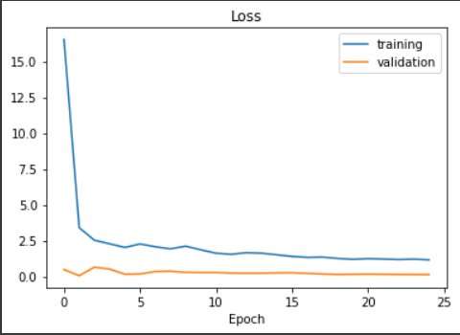
The graph for loss

Slide 16
References
https://github.com/BrainyNBright/AI-Internship-2022/tree/main/Vybhav%20Dijesh%2C%20Irbaz%20Kapadia%20%26%20Aditya%20Vijaykumar%20-%20Self-driving%20car/References

Slide 17




Thank You!

